Slide 1
Data Mining for Business
Logistic Regression
Dr. Kamesam

Slide 2


Data Mining / Machine Learning
Supervised Learning
Unsupervised
Learning
Classification
Regression
Clustering
Association Rules
Linear Regression
Nonlinear Regression
DT
C&RT
Logistic Regression
today

Slide 3
Logistic Regression
Logistic Regression is a Statistical Process, which has been around for a long time
Logistic Regression is a technique for classification, although the name has Regression in it.
In the lecture today, you will learn how the technique works for Binary Classification (only two classes, say Success, Failure)
Target Variable: A categorical Variable
Features: Numeric or Categorical
categorical features are represented by dummy variables (SPSS may do this automatically)

Slide 4
Binary Logistic Regression
Given the values of the features, Estimate the
Prob (Event occurs) and P(Event does not occur),
Ex 1: Loan approval vs. Loan Disapproval
Ex 2: Tumor is Malignant or not
Ex 3: Patient will survive for 5 more years or not
Features must be Numeric, or Categorical (represented by Dummy variables.)
Classify examples by estimating the
Prob ( an observation belongs to a class )
Use a Training / Test partition as is the standard practice.
Notes:
Prob: choose the class with the higher probability

Slide 5
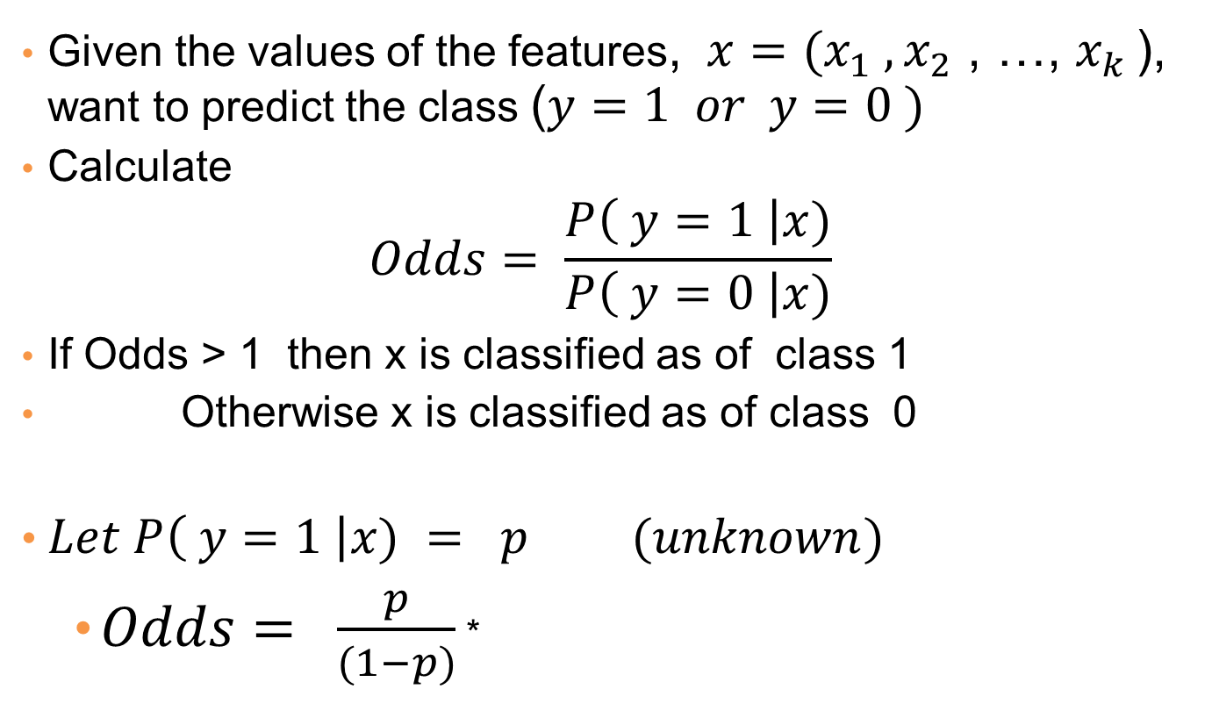
Classification Strategy
Given the values of the features, $x=(x_{1} , x_{2}$ , …, $x_{k }$), want to predict the class ($y=1 or y=0 )$
Calculate
$$Odds= \frac{P\left( y=1 \right|x)}{P\left( y=0 \right|x)}$$
If Odds > 1 then x is classified as of class 1
Otherwise x is classified as of class 0
$Let P\left( y=1 \right|x) = p (unknown)$
$Odds= \frac{p}{(1−p)}$ *
Notes:
*仅在y=1为p时成立，若设y=0为p odds为其倒数

Slide 6
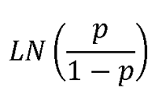
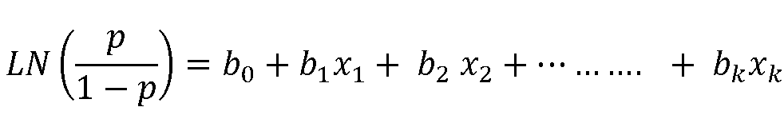
Logistic Regression Equation
We need a way of “linking” a linear combination of independent variables to the unknown probability
Ln (odds) = is called the Logit of p
Regression Equation links Logit to features
Given the training data, the regression coefficients and p the prob. of success need to be estimated.
The regression coefficients are estimated via Maximum Likelihood Estimation
We will show that p can be written in terms of the linear equation on the RHS

Slide 7
Why Not Multiple Linear Regression
For MLR, all variables must be Numeric
MLR assumes that for any given x, Y is Normally distributed. In our case Y only takes values 0 or 1, hence not Normally distributed.
In Logistic regression, our goal is to estimate the Prob (an event occurs), hence this estimate must be between 0 and 1. If we use MLR, we could get estimates below 0 or above 1

Slide 8
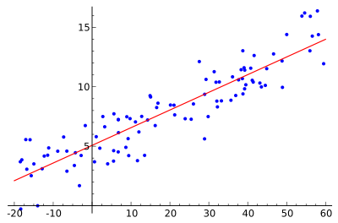
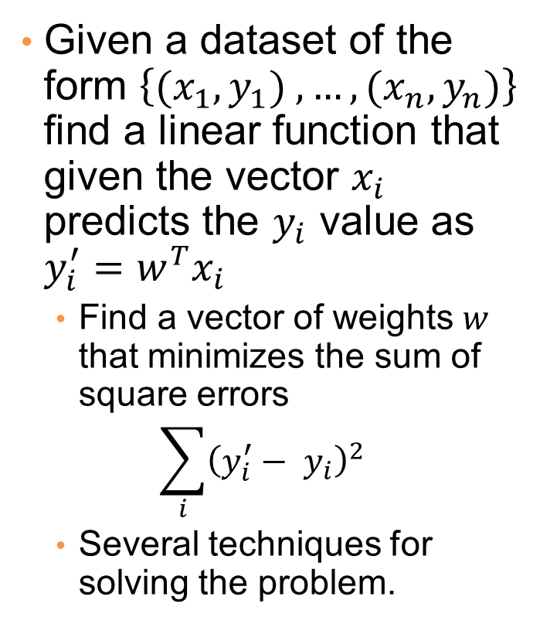
Example: Linear regression
Given a dataset of the form $\left\{{(x}_{1},y_{1}) ,…,{(x}_{n},y_{n})\right\}$ find a linear function that given the vector $x_{i}$ predicts the $y_{i}$ value as $y_{i}^{′}=w^{T}x_{i}$
Find a vector of weights $w$ that minimizes the sum of square errors
$$\sum_{i}{{\left(y_{i}^{′}− y_{i}\right)}^{2}}$$
Several techniques for solving the problem.

Slide 9


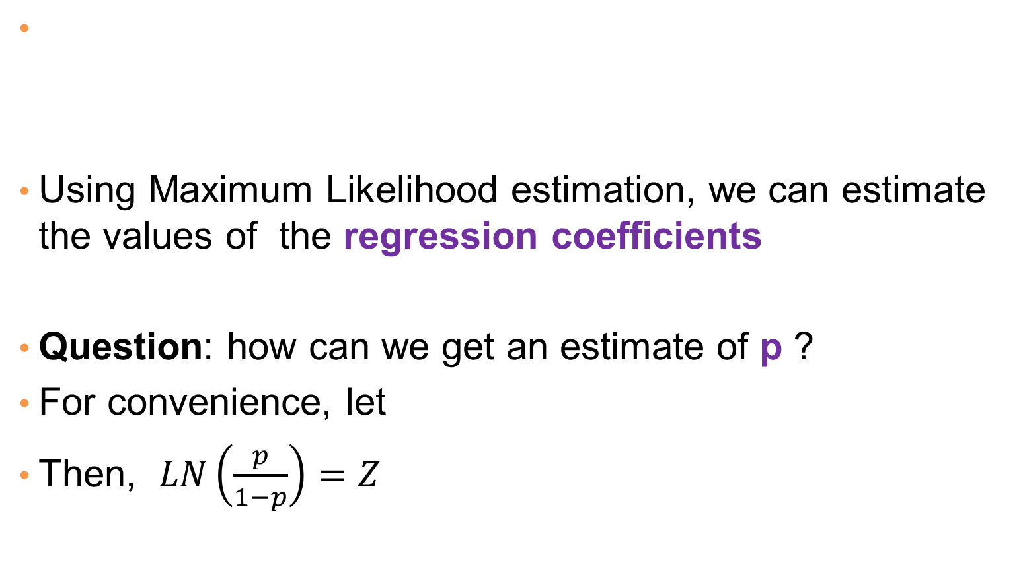
Estimating the Parameters
Using Maximum Likelihood estimation, we can estimate the values of the regression coefficients
Question: how can we get an estimate of p ?
For convenience, let
Then, $LN\left(\frac{p}{1−p}\right)=Z$

Slide 10
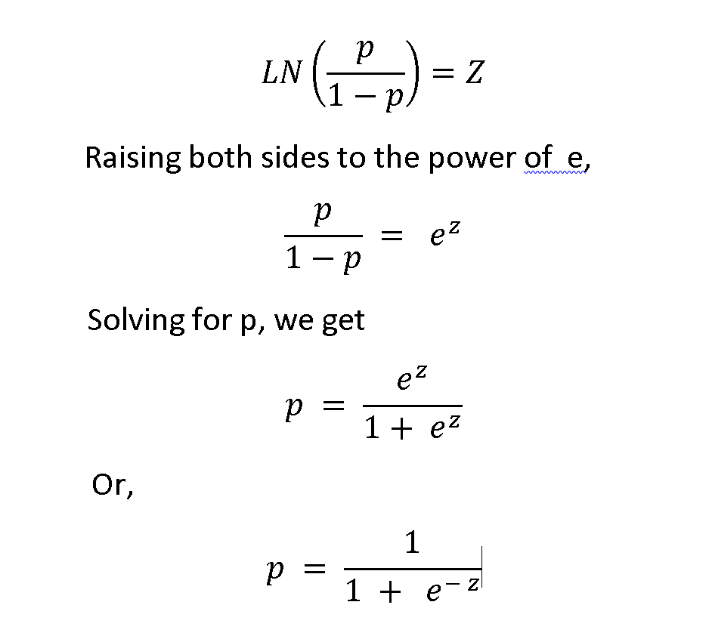
Estimating the probability p

Slide 11
Logit

Slide 12
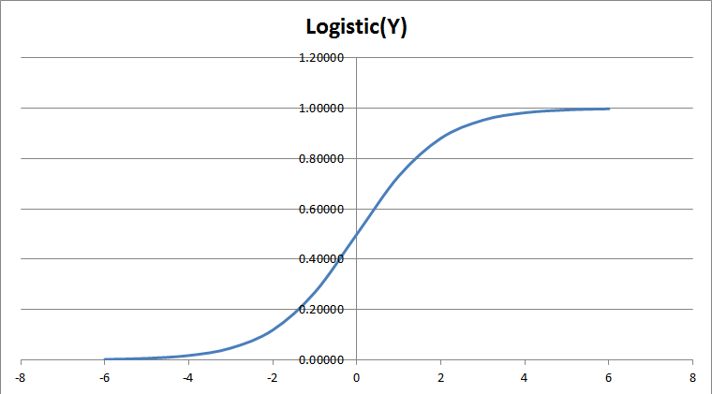
Logistic Function

Slide 13
Training the Model
Estimate the regression coefficients to Maximize log-likelyhood
The Log-likelihood statistic
Analogous to the residual sum of squares in multiple regression
It is an indicator of how much unexplained information there is after the model has been fitted.
We want to Maximize the log-likelihood function
Or we can take the –ve of the above function and minimize it.

Slide 14
Advantages of Logistic Regression as a Classifier
Produces a probability estimate for the class membership which is often very useful.
The weights (regression coefficients) can be useful for understanding the feature importance
Works for relatively large datasets
Fast to apply.
Remember that the dependent variable (Target) is a Binary variable ( 1 or 0, Success vs Failure)

Slide 15
Workshops
Excel, and
SPSS Modeler
Workshops
The EXCEL workshop will help you understand how Logistic Regression works.
When you want to build a Logistic Regression classifier, use SPSS Modeler

Slide 16
End of Lecture

Slide 17
Functions
Perceptron
Linear Regression
Sigmoid (Logistic)

Slide 18
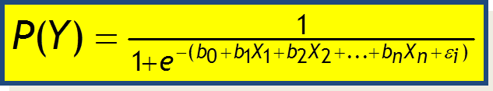
With one predictor, you may find the probability stated as
Probability estimate for given values of predictor variables
With many predictors, you may find the probability stated as

Slide 19





Classification via regression
Assume a linear classification boundary
$$w⋅x>0$$
For the positive class the bigger the value of $w⋅x$, the further the point is from the classification boundary, the higher our certainty for the membership to the positive class
Define $P(C_{+}|x)$ as an increasing function of $w⋅x$
$$w⋅x=0$$
For the negative class the smaller the value of $w⋅x$, the further the point is from the classification boundary, the higher our certainty for the membership to the negative class
Define $P(C_{−}|x)$ as a decreasing function of $w⋅x$
$$w⋅x<0$$

Slide 20
Probability Vs Odds
Odds = P(an event occurring)/P(Event not occurring)
Fair Coin Flip : P(H)= ½ Odds(H) = 0.5/0.5 = 1
Fair Die Roll : P( 1or 2)= 1/3 Odds(1or2)= (1/3)/(2/3)= ½ or 1:2
P(Diamond card)=13/52 = ¼ Odds(diamond) = (1/4)/(3/4) = 1/3 or 1:3
An ODDS RATIO is the Ratio of 2 odds
Consider a loaded coin, P(H) = 0.7 Odds(H) =0.7/0.3=2.33
Let us calcucalte the odds of getting a H with a loaded coin, vs a Fair coin
Odds Ratio = odds₁ / Odds ₂ = 2.33/ 1 = 2.33
So, the odds of getting a H with a loaded coin are 2.33 times higher than the odds of getting H with a fair coin

Slide 21
Odds Ratio in Logistic Regression
The Odds Ratio for a variable in Logistic Regression represents how the odds change with a one unit increase in that variable, holding all other variables constant.
It is important to understand the above interpretation of the coefficients in Logistic Regression, as opposed to a much simpler interpretation in Multiple Linear Regression.

Slide 22
Interpreting Odds Ratio: example
Example : Body weight & Sleep Apnea (SA)
Two classes: Have SA or do not have SA
Suppose Weight variable has an odds ratio of 1.07. This means one lb increase in weight increases odds of SA by 1.07 (or 7%)
Let a 10 lb weight increase have odds ratio 1.98 (odds of SA are nearly doubled)
Let a 20lb weight increase have odds ratio of 3.87 (odds of SA are up by 4 times).

Slide 23
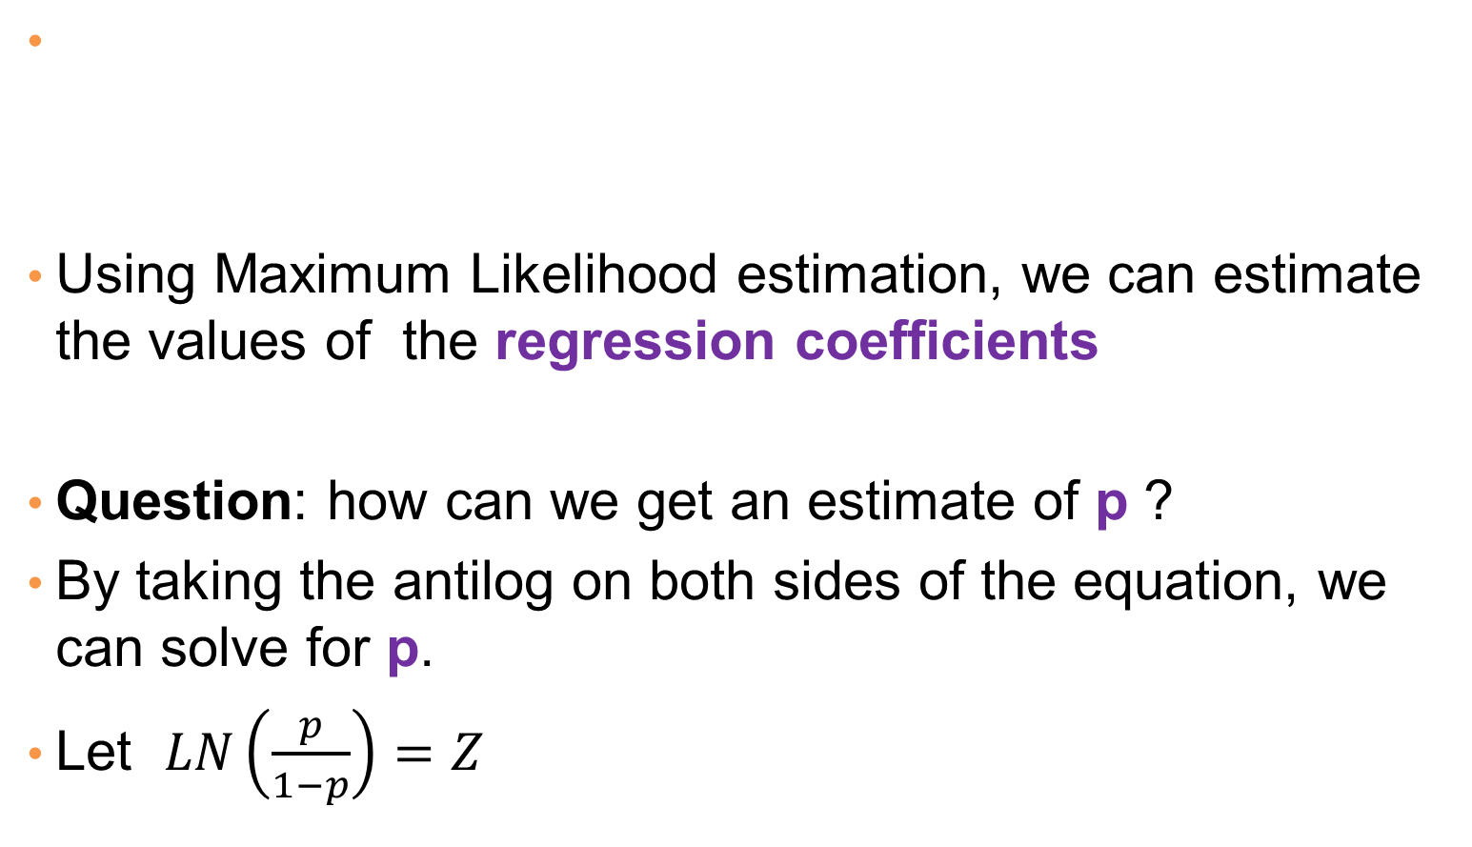
Estimating the Parameters
Using Maximum Likelihood estimation, we can estimate the values of the regression coefficients
Question: how can we get an estimate of p ?
By taking the antilog on both sides of the equation, we can solve for p.
Let $LN\left(\frac{p}{1−p}\right)=Z$

Slide 24
Logistic Regression Equation
Given the training data, the regression coefficients and p the prob. of success need to be estimated.
Using Maximum Likelihood estimation, we can estimate the regression coefficients
Question: how can estimate p ?
We will see that p can be written in terms of the linear function on the RHS. Note that p depends on the values of the features as well as the regression coefficients

Slide 25
Classification with P(Y)
Logistic Regression is a popular technique for classification.
Once you get the P(Y=1), if the probability > 0.5, classify as class 1 (success) if not classify as class 0 (failure)
More importantly, the classification also comes with the class probability

